Slide 1
Modulation & Coding: Lab 1
Jean-François Determe (jdeterme@ulb.ac.be)
Trung Hien Nguyen (trung-hien.nguyen@ulb.ac.be)

Slide 2
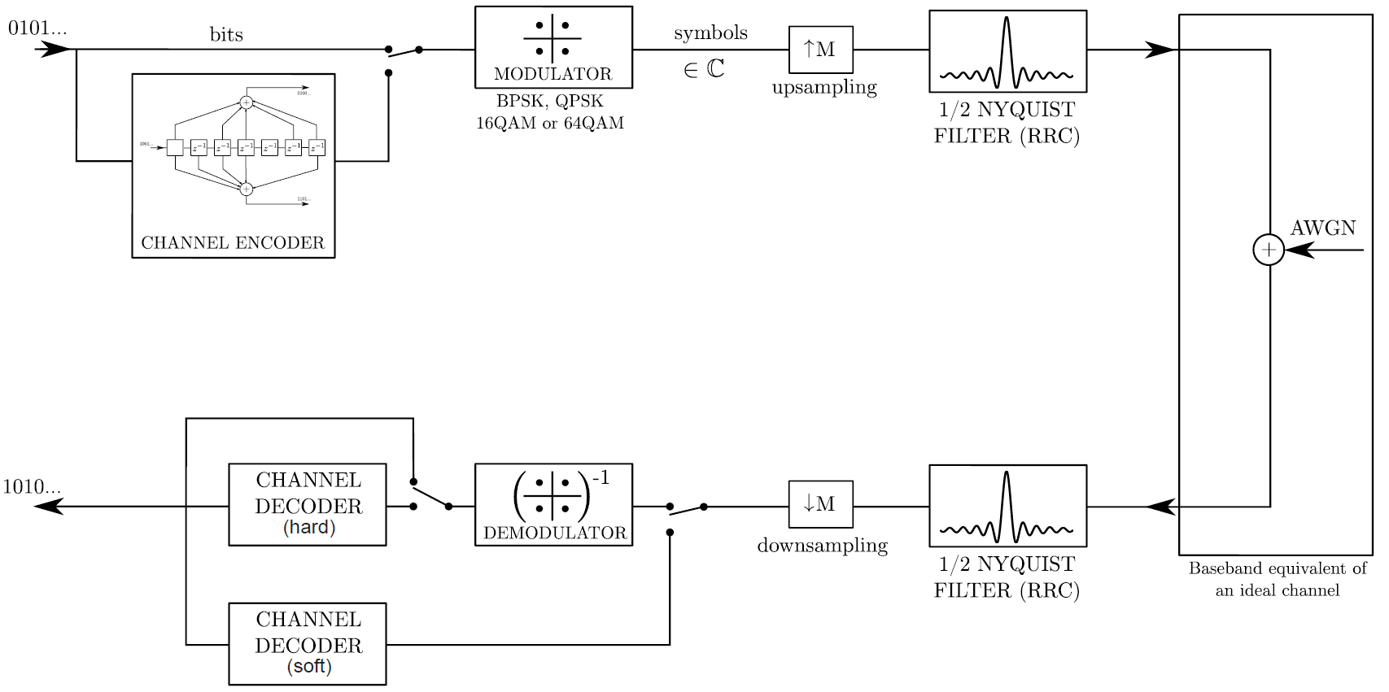
Goal of the first lab
Goal: Implement in Matlab: TX, RX, and noise addition.
TX
RX
Noise

Slide 3
Outline
How to add the AWG noise (Hien)
How to design the root raised cosine filters (Hien)
How to perform the convolutions (Jean-François)
Miscellaneous tips (Jean-François)
TX
RX
Noise

Slide 4
Outline
How to add the AWG noise (Hien)
How to design the root raised cosine filters (Hien)
How to perform the convolutions (Jean-François)
Miscellaneous tips (Jean-François)
TX
RX
Noise

Slide 5
Additive white Gaussian noise (AWGN)
Noise affects each transmitted samples independently => signal_noise = signal + noise
Additive zero-mean white Gaussian noise: randn
Noise generation
sqrt(NoisePower/2) * ( randn(1, length(noise)) + 1i*randn(1, length(noise)) )
Figure of merit: EbN0 (normalized version of SNR)
Eb – bit energy = SignalEnergy * BitTime (Tb)
N0 – noise power spectral density = NoisePower / Bandwidth
?

Slide 6
Additive white Gaussian noise (AWGN)
Bit energy
Eb = SignalPower / NbEncodedBit
SignalEnergy = (trapz(abs(signal).^2))*(1/Fsampling)
Note: Eb = Eb/2 (Slide 32 of signal representation)
Noise power
N0 = Eb/EbN0
NoisePower = 2*N0*Fsampling
Example EbN0 = 5 dB
Signal (1+1i) + Noise
Noise
Notes:
2*N0 for the complete simulated bandwidth

Slide 7
Outline
How to add the AWG noise (Hien)
How to design the root raised cosine filters (Hien)
How to perform the convolutions (Jean-François)
Miscellaneous tips (Jean-François)
TX
RX
Noise

Slide 8
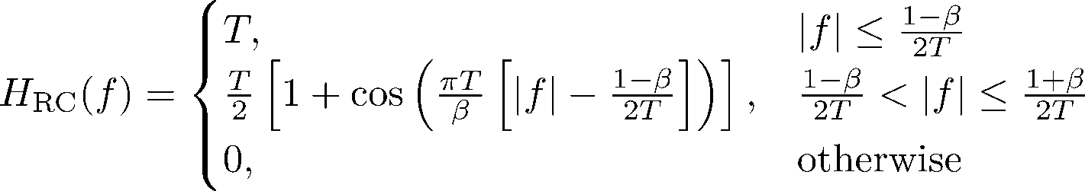

Root-raised cosine (RRC) filter
Time and frequency domain representation
Idea: designing the filter in frequency domain; impulse response obtained by IFFT
Parameters for the filter design
Roll-off factor (β)
Symbol frequency (1/T); sampling frequency (Fsampling)
# taps of the filter: time extension & frequency resolution

Slide 9
RRC filter Frequency domain generation
Frequency grid definition – f variable
RRCTaps = length(H(f))
fmax = Fs*(RRCTaps-1) / 2*RRCTaps
f = linspace(-fmax, fmax, RRCtaps)
Note:
You may need to normalize H(f) to get the impulse response equal to 1 @ t = 0
Spectrum
f
-fmax
0
fmax

Slide 10
RRC filter Time domain generation
Time axis
Time resolution: Delta_t = 1/(2*fmax)
t = (-(RRCTaps-1)/2 : (RRCTaps-1)/2) * Delta_t
Impulse response: use the ifft and ifftshift functions
Example: β = 0.5; Tsymb = 1e-6; Fsampling = 8e8

Slide 11
Outline
How to add the AWG noise (Hien)
How to design the root raised cosine filters (Hien)
How to perform the convolutions (Jean-François)
Miscellaneous tips (Jean-François)
TX
RX
Noise

Slide 12

Convolution (1)
Function to be used: conv(vec1, vec2)
vec1 = upsampled symbols
vec2 = impulse reponse of the root raised cosine filter
RRCTaps = # elems in vec2
vec1
conv
vec2

Slide 13

Convolution (2)
vec1
conv
vec2
Explanation in the next slides with
length(conv(vec1,vec2)) == length(vec1) + length(vec2) - 1 instead of length(conv(vec1,vec2)) == length(vec1)
1 BPSK symbol (1+0*i)
Oversampling factor M = 4
RRCTaps = 33
Symbol frequency = 1 MHz
Roll-off = 0.3

Slide 14
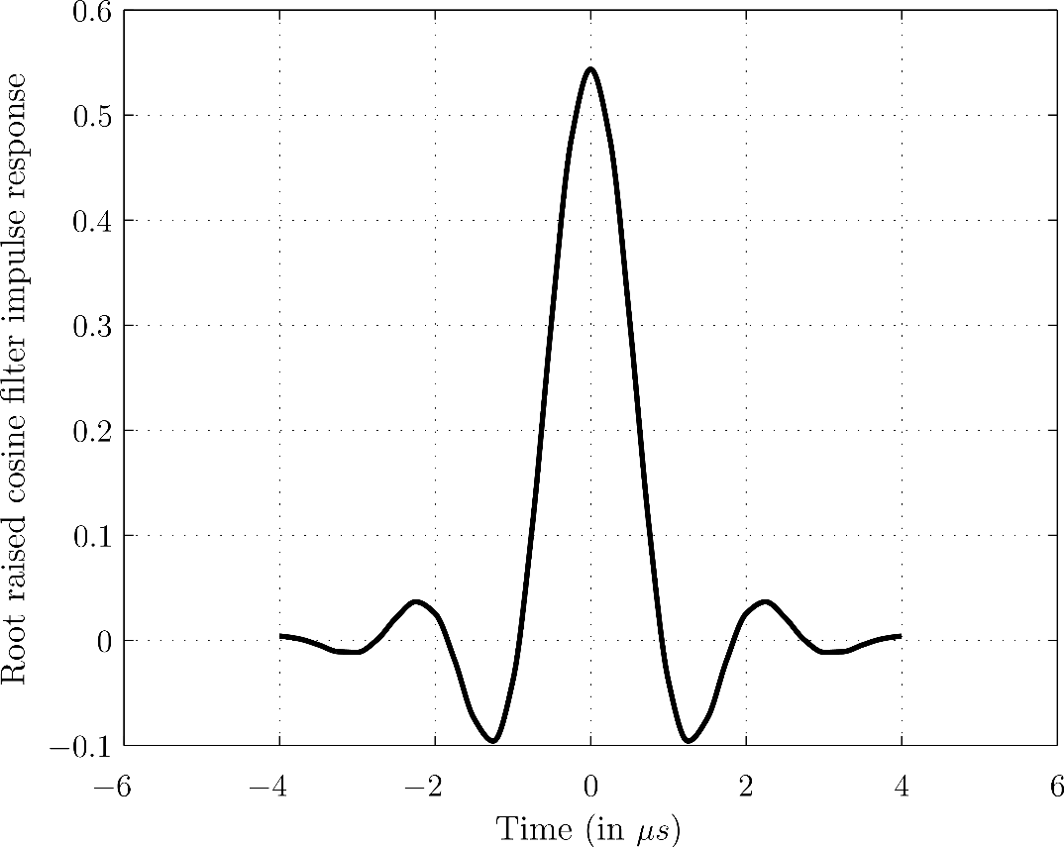
Convolution (3)
vec1
conv
vec2
How the continuous time RRC filter looks like in the time domain:
= causal part
= non-causal part
Oversampling factor M = 4
RRCTaps = 33
Symbol frequency = 1 MHz
Roll-off = 0.3
Notes:
Time support is limited to 0.5*(RRCTaps-1)*Ts = 16*(1/4 MHz) = 4 µs where Ts is the time delay separating two consecutive samples at the simulation rate fs = M*fSymbol = 4 MHz.
Note that an odd number of taps implies a symmetrical RRC filter.

Slide 15



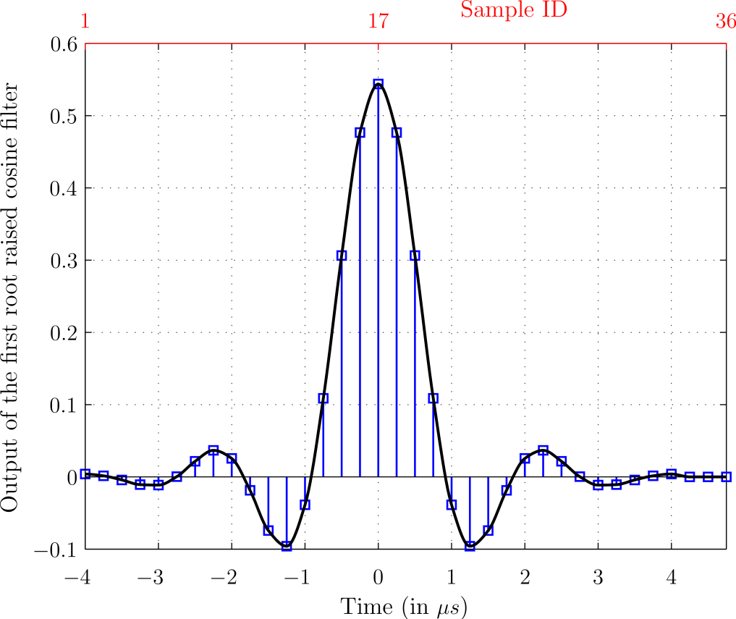
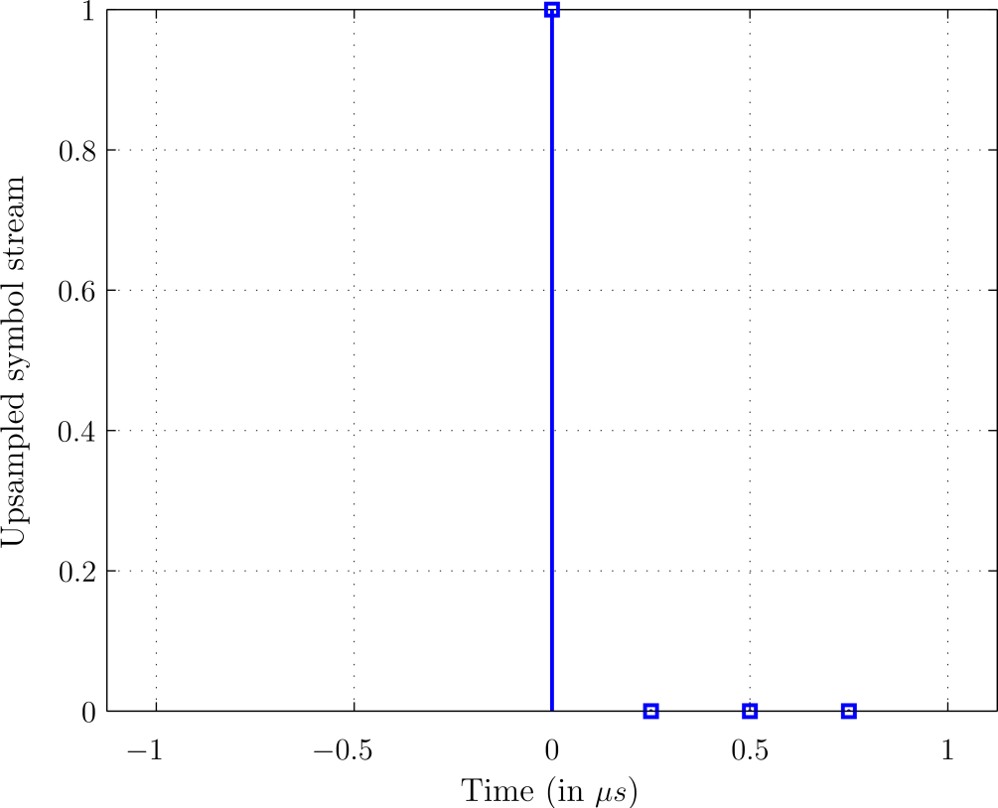
Convolution (4)
1 BPSK symbol (1+0*i)
Oversampling factor M = 4
RRCTaps = 33
Symbol frequency = 1 MHz
Roll-off = 0.3
vec1
conv
vec2
conv(vec1,vec2)
vec1
Notes:
Left figure:
The equivalent continuous time signal is the Dirac pulse \delta(t)
Right figure:
Dark continuous curve = continuous time signal
Blue signal = discrete time signal, i.e., it is the continuous time signal sampled at a rate equal to M*fSymbol
The theory in the continuous time domain predicts that the signal becomes non-zero for negative times (-> non-causal part of the filter). Similarly, the causal part of the filter extends the duration of the signal.
It is fairly natural to expect that this effect also occurs when doing discrete time simulations.
In practice: physical time t = 0 µs now corresponds to sample 0.5*(RRCTaps-1)+1= 17. Indeed, by discarding the sample corresponding to the physical time t = 0 µs, there are RRCTaps-1 taps left. RRCTaps-1 is an even number in this case which means that the number of taps for the « left » and « right » part of the filter are both equal to (RRCTaps-1)/2.

Slide 16
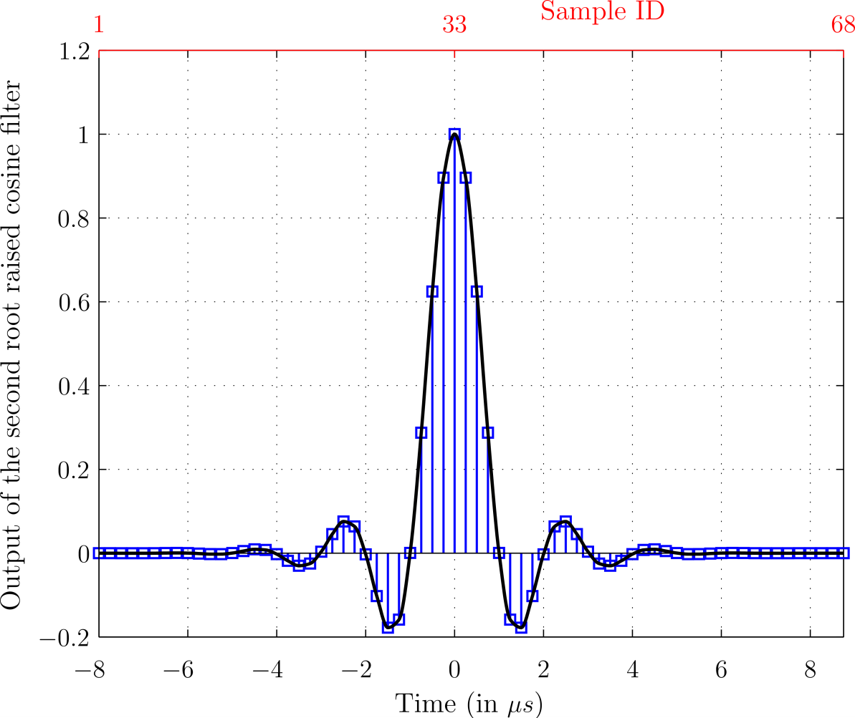
Convolution (5)
After the convolution at the RX (without noise):
In practice: physical time t = 0 µs now corresponds to sample 2*0.5*(RRCTaps-1)+1 = RRCTaps = 33.
Never discard the additional samples in between the two convolutions -> it creates inter symbol interference (ISI)
Discarding the first RRCTaps-1 samples at the beginning of the RX signal basically ensures that 1st sample corresponds to physical time t = 0 µs.
Usually, you want to discard the additional samples at the end of the signal as well.
Notes:
Black continuous curve = continuous time signal
Blue signal = discrete time signal, i.e., it is the continuous time signal sampled at a rate equal to M*fSymbol

Slide 17
Outline
How to add the AWG noise (Hien)
How to design the root raised cosine filters (Hien)
How to perform the convolutions (Jean-François)
Miscellaneous tips (Jean-François)
TX
RX
Noise

Slide 18
Tips (1)
Useful functions/quantities (use doc [Function name] for help)
Name | Purpose
1i | Variable representing the complex number 0+1*i
randi | Generates random integers
length | Returns the length of a vector (largest dimension for 2D arrays)
numel | Returns the # of elems of a vector or a matrix
size | Returns the size of a matrix
reshape | Reshapes a matrix/vector to another one of prescribed dimensions -> useful to convert matrices to vectors and inversely
circshift | Circular permutation of the columns of a matrix (if vector, ensure that it is a column vector)
rng | Fixes the seed of the random number generator
Notes:
Use 1i instead of i or j in your simulations!
Numel, size, reshape, and circshift are probably useless for the first lab

Slide 19
Tips (2)
Functions mapping and demapping for converting bits to symbols and symbols to bits, respectively.
The functions are provided by us and should be included in the folder from which the simulations are run
if (bitsPerSymbol > 1)
txSymbols = mapping(txBits.', bitsPerSymbol, 'qam'); % Symbols at the tx
else % BPSK case
txSymbols = mapping(txBits.', bitsPerSymbol, 'pam');
end
if (bitsPerSymbol > 1)
rxBits = demapping(rxSymbols, bitsPerSymbol, 'qam').';
else % BPSK case
rxBits = demapping(real(rxSymbols), bitsPerSymbol, 'pam').';
end
Notes:
The input vectors for both functions should be column vectors.
In the BPSK case, the demapping function requires a real column vector. Taking the real part of the symbol vectors (rxSymbols) basically boils down to projecting the received complex symbols onto the real axis.

Slide 20
Tips (3)
Last tips:
Never manually inject numbers depending on simulation parameters into your code, use variables instead (e.g. nbBits, RRCTaps, bitsPerSymbol, EbN0). Otherwise:
Difficult/Time-consuming to change the parameters afterwards in all the functions
Debugging made easier if parameters can be easily changed
variable.’ = transpose while variable’ = Hermitian transpose
Use semilogy instead of plot to plot the BER as a function of Eb/N0
In your reports, explicitly answer the questions of the project statement
If Matlab < R2014b and if LaTeX is installed locally, you can generate nice PDF figures by using the scripts matlabfrag and mlf2pdf.
A template you can use to generate nice figures using mlf2pdf is available.
Now: live demo of mlf2pdf/matlabfrag.

